Slide 1
Do-more Technical Training
System Configuration
(CPU Configuration)

Slide 2
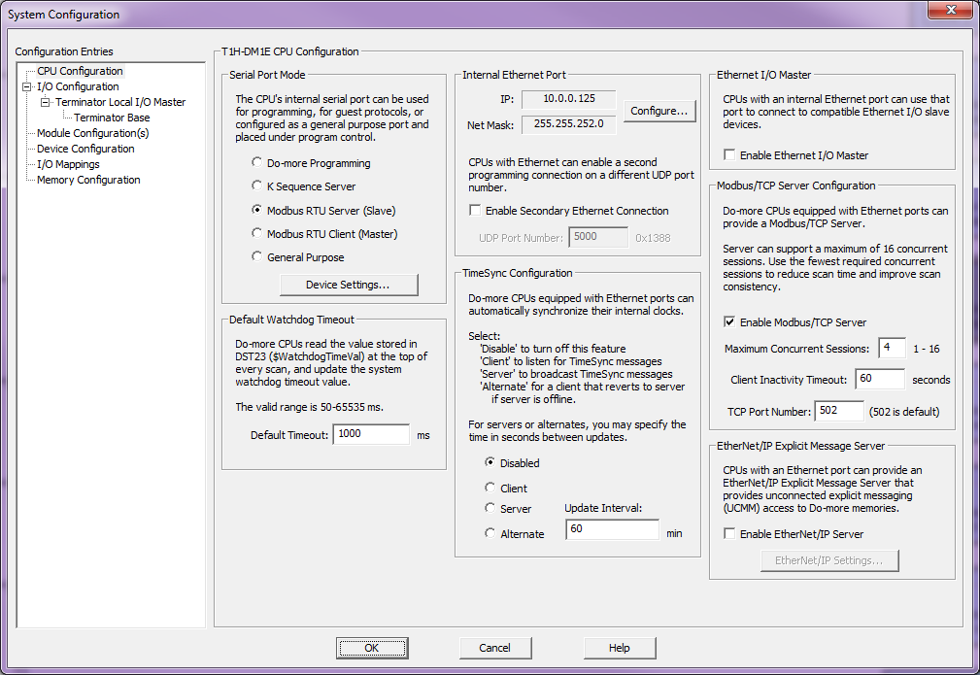
System Configuration
CPU Configuration
Serial Port Mode
Modbus/TCP Server Configuration
TimeSync Configuration
Default Watchdog Timeout
Ethernet I/O Master
Internal Ethernet Port
EtherNet/IP Explicit Message Server
Notes:
Launchpad: nothing new here
Project Browser:
Buttons
Control Logic Filter – Display filter
New Code Block – Create new code blocks
Execution Order – Change execution order of blocks
Status – Shows which blocks are enabled to run
Sort Code Blocks – Change display order
Sort Memory – Change display order
Control Logic
Configuration
Tools
Debug View
NOTE: Message Dump – enables dump to Do-more Logger, $EnableMsgDump (ST36)
Data View
PID Overview

Slide 3
System Configuration
CPU Configuration
Serial Port Mode
RS-232, RJ12 connector
Non-isolated, full duplex, ESD & surge protection
Power pins 1-2, reverse polarity & overload protection
RXD, TXD load = 3KΩ 1000pF
D2=DSCBL, USB-RS3232 w/D2-DSCBL, FA-CABKIT, FA-ISOCON (RS-232 to RS-422/485), EA-MG-PGM
Notes:
Launchpad: nothing new here
Project Browser:
Buttons
Control Logic Filter – Display filter
New Code Block – Create new code blocks
Execution Order – Change execution order of blocks
Status – Shows which blocks are enabled to run
Sort Code Blocks – Change display order
Sort Memory – Change display order
Control Logic
Configuration
Tools
Debug View
NOTE: Message Dump – enables dump to Do-more Logger, $EnableMsgDump (ST36)
Data View
PID Overview

Slide 4
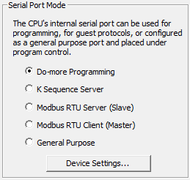
System Configuration
CPU Configuration
Serial Port Mode
Do-more Programming (default)
K Sequence Server
Serves up DL-memory
Modbus RTU Server (Slave)
Serves up M-memory
Modbus RTU Client (Master)
Uses the MRX / MWX instructions
General Purpose – (Master/Slave)
Uses the STREAMIN / STREAMOUT instructions
Notes:
Launchpad: nothing new here
Project Browser:
Buttons
Control Logic Filter – Display filter
New Code Block – Create new code blocks
Execution Order – Change execution order of blocks
Status – Shows which blocks are enabled to run
Sort Code Blocks – Change display order
Sort Memory – Change display order
Control Logic
Configuration
Tools
Debug View
NOTE: Message Dump – enables dump to Do-more Logger, $EnableMsgDump (ST36)
Data View
PID Overview

Slide 5
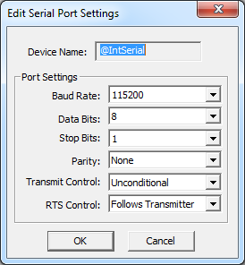
System Configuration
CPU Configuration
Serial Port Mode
Do-more Programming (default)
Baud Rate: 300, 1200, 2400, 4800, 9600, 19.2K, 38.4K, 57.6K, 115.2K
Data Bits: 7, 8
Stop Bits: 1, 2
Parity: None, Odd, Even
Transmit Control:
Unconditional – Xmit w/o delay
Wait for CTS
Delayed 5ms, 50ms, 250ms, 500ms – Xmit after asserting RTS + delay
RTS Control:
Follows Transmitter – RTS controlled by xmitter
Manual – RTS controlled by IntSerial.RTS
Off/On – Forces RTS
Notes:
Launchpad: nothing new here
Project Browser:
Buttons
Control Logic Filter – Display filter
New Code Block – Create new code blocks
Execution Order – Change execution order of blocks
Status – Shows which blocks are enabled to run
Sort Code Blocks – Change display order
Sort Memory – Change display order
Control Logic
Configuration
Tools
Debug View
NOTE: Message Dump – enables dump to Do-more Logger, $EnableMsgDump (ST36)
Data View
PID Overview

Slide 6
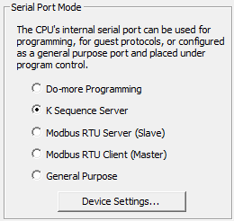
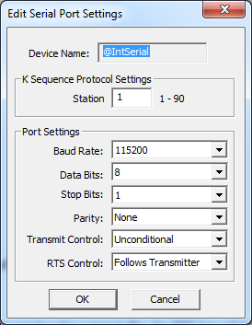
System Configuration
CPU Configuration
Serial Port Mode
K Sequence Server
Serves up DLX, DLY, DLC & DLV
Station: 1 - 90
Baud Rate: 300, 1200, 2400, 4800, 9600, 19.2K, 38.4K, 57.6K, 115.2K
Data Bits: 7, 8
Stop Bits: 1, 2
Parity: None, Odd, Even
Transmit Control:
Unconditional – Xmit w/o delay
Wait for CTS
Delayed 5ms, 50ms, 250ms, 500ms – Xmit after asserting RTS + delay
RTS Control:
Follows Transmitter – RTS controlled by xmitter
Manual – RTS controlled by IntSerial.RTS
Off/On – Forces RTS
Notes:
Launchpad: nothing new here
Project Browser:
Buttons
Control Logic Filter – Display filter
New Code Block – Create new code blocks
Execution Order – Change execution order of blocks
Status – Shows which blocks are enabled to run
Sort Code Blocks – Change display order
Sort Memory – Change display order
Control Logic
Configuration
Tools
Debug View
NOTE: Message Dump – enables dump to Do-more Logger, $EnableMsgDump (ST36)
Data View
PID Overview

Slide 7
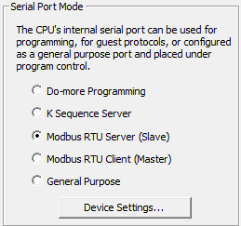
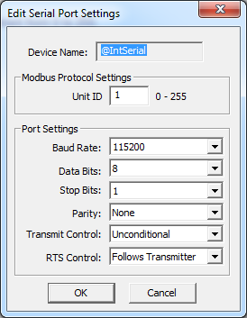
System Configuration
CPU Configuration
Serial Port Mode
Modbus RTU Server (Slave)
Serves up MI, MC, MIR, & MHR
Unit ID: 0 - 255
Baud Rate: 300, 1200, 2400, 4800, 9600, 19.2K, 38.4K, 57.6K, 115.2K
Data Bits: 7, 8
Stop Bits: 1, 2
Parity: None, Odd, Even
Transmit Control:
Unconditional – Xmit w/o delay
Wait for CTS
Delayed 5ms, 50ms, 250ms, 500ms – Xmit after asserting RTS + delay
RTS Control:
Follows Transmitter – RTS controlled by xmitter
Manual – RTS controlled by IntSerial.RTS
Off/On – Forces RTS
Notes:
Launchpad: nothing new here
Project Browser:
Buttons
Control Logic Filter – Display filter
New Code Block – Create new code blocks
Execution Order – Change execution order of blocks
Status – Shows which blocks are enabled to run
Sort Code Blocks – Change display order
Sort Memory – Change display order
Control Logic
Configuration
Tools
Debug View
NOTE: Message Dump – enables dump to Do-more Logger, $EnableMsgDump (ST36)
Data View
PID Overview

Slide 8
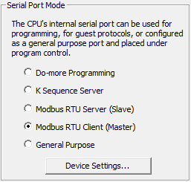
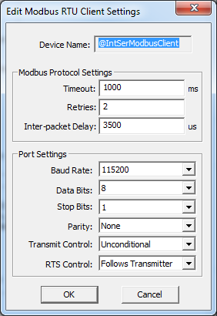
System Configuration
CPU Configuration
Serial Port Mode
Modbus RTU Client (Master)
Master has no Unit ID address
Use MRX & MWX instructions
Timeout: 0 – 32,767 ms; time for slave to respond
Retries: 0 – 255
Inter-packet Delay: 0 – 65,535 µs; between packets
Baud Rate: 300, 1200, 2400, 4800, 9600, 19.2K, 38.4K, 57.6K, 115.2K
Data Bits: 7, 8
Stop Bits: 1, 2
Parity: None, Odd, Even
Transmit Control:
Unconditional – Xmit w/o delay
Wait for CTS
Delayed 5ms, 50ms, 250ms, 500ms – Xmit after asserting RTS + delay
RTS Control:
Follows Transmitter – RTS controlled by xmitter
Manual – RTS controlled by IntSerial.RTS
Off/On – Forces RTS
Notes:
Launchpad: nothing new here
Project Browser:
Buttons
Control Logic Filter – Display filter
New Code Block – Create new code blocks
Execution Order – Change execution order of blocks
Status – Shows which blocks are enabled to run
Sort Code Blocks – Change display order
Sort Memory – Change display order
Control Logic
Configuration
Tools
Debug View
NOTE: Message Dump – enables dump to Do-more Logger, $EnableMsgDump (ST36)
Data View
PID Overview

Slide 9
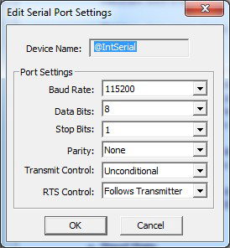
System Configuration
CPU Configuration
Serial Port Mode
General Purpose
Use STREAMIN & STREAMOUT instructions
Baud Rate: 300, 1200, 2400, 4800, 9600, 19.2K, 38.4K, 57.6K, 115.2K
Data Bits: 7, 8
Stop Bits: 1, 2
Parity: None, Odd, Even
Transmit Control:
Unconditional – Xmit w/o delay
Wait for CTS
Delayed 5ms, 50ms, 250ms, 500ms – Xmit after asserting RTS + delay
RTS Control:
Follows Transmitter – RTS controlled by xmitter
Manual – RTS controlled by IntSerial.RTS
Off/On – Forces RTS
Notes:
Launchpad: nothing new here
Project Browser:
Buttons
Control Logic Filter – Display filter
New Code Block – Create new code blocks
Execution Order – Change execution order of blocks
Status – Shows which blocks are enabled to run
Sort Code Blocks – Change display order
Sort Memory – Change display order
Control Logic
Configuration
Tools
Debug View
NOTE: Message Dump – enables dump to Do-more Logger, $EnableMsgDump (ST36)
Data View
PID Overview

Slide 10
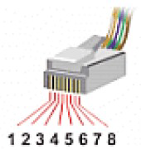
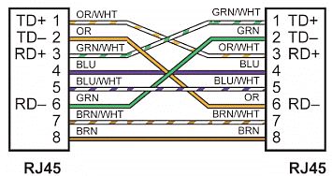
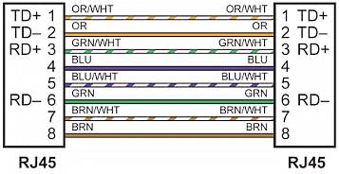
Built-In Ethernet Port
System Configuration
10Base-T / 100Base-T RJ45 connector
Isolated, full duplex, ESD & surge protection
10 / 100 Mbps
Patch (straight-thru) or crossover cabling
PROTOCOL | NOTES: | PROTOCOL | NOTES:
Do-more programming | Always enabled – serves up all Do-more memory | SMTP | EMAIL
Peerlink | PEERLINK | SNTP | NETTIME
Modbus TCP | Client (master) – MRX / MWX Server (slave) – serves up MI, MC, MIR, MHR | Custom UDP | PACKETIN, PACKETOUT
DirectLOGIC RX/WX | Always enabled – serves up DLX, DLY, DLC, DLV | Custom TCP | Client (master) – OPENTCP, STREAMIN, STREAMOUT Server (slave) – TCPLISTEN, STREAMIN, STREAMOUT
K-sequence | Server (slave) – serves up DLX, DLY, DLC, DLV | Ethernet I/O | Maps 16 EBC100 slaves I/O
EtherNet/IP | Client (master) - EIPMSG Server (slave) – serves up configured blocks | ICMP | PING
DNS | DNSLOOKUP | TimeSync | Client (master) Server (slave)
Notes:
Launchpad: nothing new here
Project Browser:
Buttons
Control Logic Filter – Display filter
New Code Block – Create new code blocks
Execution Order – Change execution order of blocks
Status – Shows which blocks are enabled to run
Sort Code Blocks – Change display order
Sort Memory – Change display order
Control Logic
Configuration
Tools
Debug View
NOTE: Message Dump – enables dump to Do-more Logger, $EnableMsgDump (ST36)
Data View
PID Overview

Slide 11
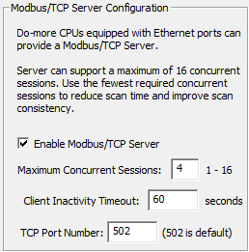
System Configuration
CPU Configuration
Modbus/TCP Server Configuration
Serves up MI (Inputs), MC (Coils), MIR (Input Registers), MHR (Holding Registers)
Enable Modbus/TCP Server: enabled by default
Maximum Concurrent Sessions: 1 – 16
Client Inactivity Timeout: closes TCP connection if master is not heard from; 0 – 65,535 seconds
TCP Port Number: 0 – 65,535
Notes:
Launchpad: nothing new here
Project Browser:
Buttons
Control Logic Filter – Display filter
New Code Block – Create new code blocks
Execution Order – Change execution order of blocks
Status – Shows which blocks are enabled to run
Sort Code Blocks – Change display order
Sort Memory – Change display order
Control Logic
Configuration
Tools
Debug View
NOTE: Message Dump – enables dump to Do-more Logger, $EnableMsgDump (ST36)
Data View
PID Overview

Slide 12
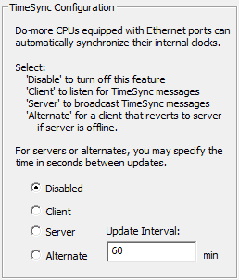
System Configuration
CPU Configuration
TimeSync Configuration
Automatic time sync network
1 server
1 or more alternate server(s)
1 or more client(s)
TCP/IP broadcast (network domain)
Disabled: default
Client:
Listens for server’s time-sync packet
If heard →
$TimeSynced (ST23) = ON
Sets real-time clock
Keeps listening (times down from Update Interval)
If Update Interval times out →
$TimeSynced (ST23) = OFF
Keeps listening (times down from Update Interval)
Server: transmits 3 time-sync packets (5 second intervals) every Update Interval)
Alternate:
Normally a Client
If Update Interval times out + 15 seconds →
Becomes the new Server
Update Interval: 0 – 32,767 minutes (22 days)
Notes:
Launchpad: nothing new here
Project Browser:
Buttons
Control Logic Filter – Display filter
New Code Block – Create new code blocks
Execution Order – Change execution order of blocks
Status – Shows which blocks are enabled to run
Sort Code Blocks – Change display order
Sort Memory – Change display order
Control Logic
Configuration
Tools
Debug View
NOTE: Message Dump – enables dump to Do-more Logger, $EnableMsgDump (ST36)
Data View
PID Overview

Slide 13
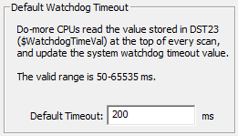
System Configuration
CPU Configuration
Default Watchdog Timeout
Time allowed for 1 scan
Default Timeout: 50 – 65,535 ms
$WatchdogTimeVal (DST23)
If exceeded →
STOP mode
Error message in System Information
ERR light
Notes:
Launchpad: nothing new here
Project Browser:
Buttons
Control Logic Filter – Display filter
New Code Block – Create new code blocks
Execution Order – Change execution order of blocks
Status – Shows which blocks are enabled to run
Sort Code Blocks – Change display order
Sort Memory – Change display order
Control Logic
Configuration
Tools
Debug View
NOTE: Message Dump – enables dump to Do-more Logger, $EnableMsgDump (ST36)
Data View
PID Overview

Slide 14
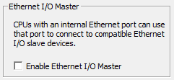
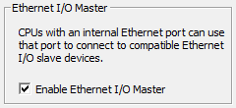
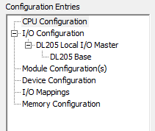
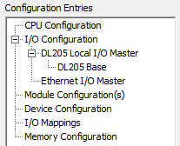
System Configuration
CPU Configuration
Ethernet I/O Master
Enable Ethernet I/O Master
Creates $EthIOMaster structure
Creates Ethernet I/O Master entry in the I/O Configuration
Ethernet I/O Master Structure Members (68)
Warning | SlaveErrors | SlavexError
Error | SlavexRetryCnt | SlavexErrorInfo
SlaveWarnings | SlavexUpdateCnt | x = 0-15
Notes:
Launchpad: nothing new here
Project Browser:
Buttons
Control Logic Filter – Display filter
New Code Block – Create new code blocks
Execution Order – Change execution order of blocks
Status – Shows which blocks are enabled to run
Sort Code Blocks – Change display order
Sort Memory – Change display order
Control Logic
Configuration
Tools
Debug View
NOTE: Message Dump – enables dump to Do-more Logger, $EnableMsgDump (ST36)
Data View
PID Overview

Slide 15
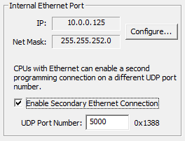
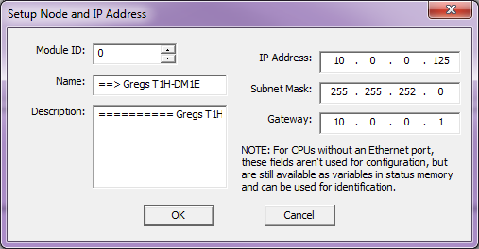
System Configuration
CPU Configuration
Internal Ethernet Port
Configure IP parameters
Normal Do-more Designer Programming session uses TCP/IP Port # 28,784 (7070 hex).
Checking Enable Secondary Ethernet Connection allows an additional TCP/IP Port # of your choice.
UDP Port Number: 5000 – 65,535 (except 28,784)
Notes:
Launchpad: nothing new here
Project Browser:
Buttons
Control Logic Filter – Display filter
New Code Block – Create new code blocks
Execution Order – Change execution order of blocks
Status – Shows which blocks are enabled to run
Sort Code Blocks – Change display order
Sort Memory – Change display order
Control Logic
Configuration
Tools
Debug View
NOTE: Message Dump – enables dump to Do-more Logger, $EnableMsgDump (ST36)
Data View
PID Overview

Slide 16
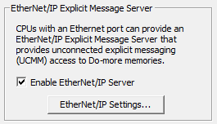
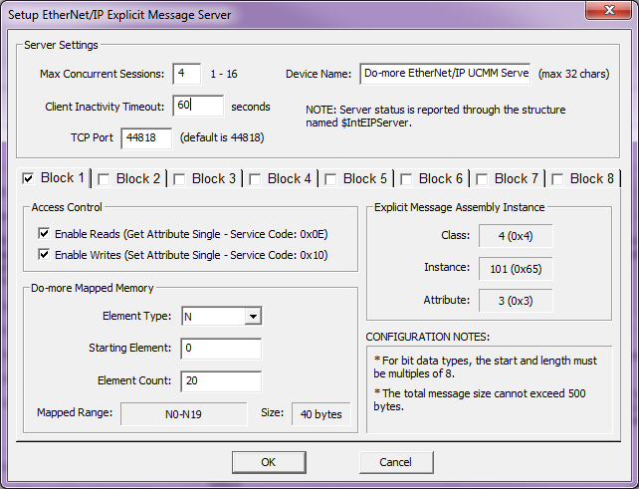
System Configuration
CPU Configuration
EtherNet/IP Explicit Message Server
EtherNet/IP Settings…
Notes:
Launchpad: nothing new here
Project Browser:
Buttons
Control Logic Filter – Display filter
New Code Block – Create new code blocks
Execution Order – Change execution order of blocks
Status – Shows which blocks are enabled to run
Sort Code Blocks – Change display order
Sort Memory – Change display order
Control Logic
Configuration
Tools
Debug View
NOTE: Message Dump – enables dump to Do-more Logger, $EnableMsgDump (ST36)
Data View
PID Overview

