Slide 1
Do-more Technical Training
System Security

Slide 2
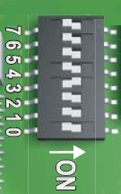
System Security
Hardware Security
Mode Switch in RUN or STOP provides a minimal protection against software-commanded PLC mode change
Dipswitch #3 offers the ability to disable firmware/gate array updates

Slide 3
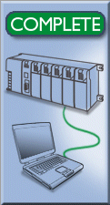
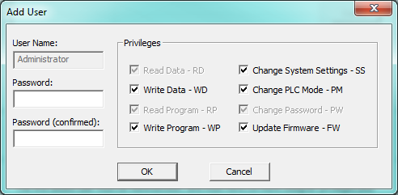
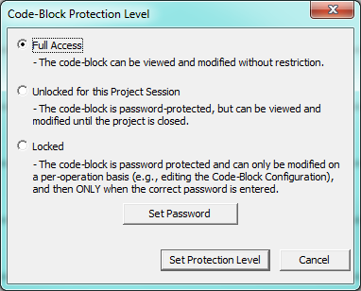
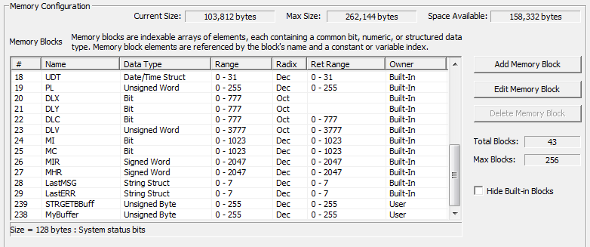
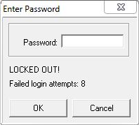
System Security
Multiple User Accounts
Session-based Communication
Protocol-specific Memory
Code-Block Protection
Sessions Locked Out

Slide 4
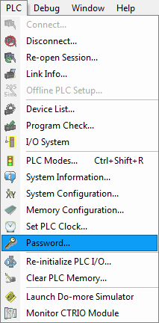
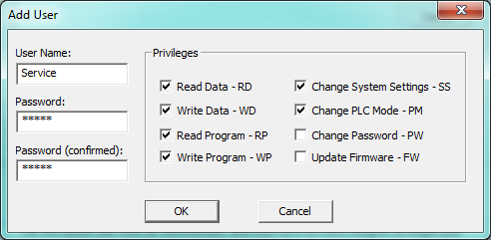
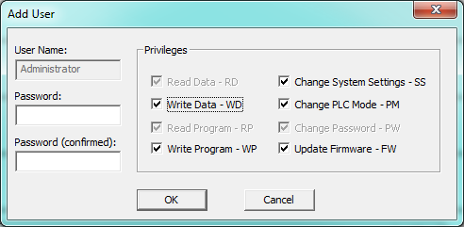
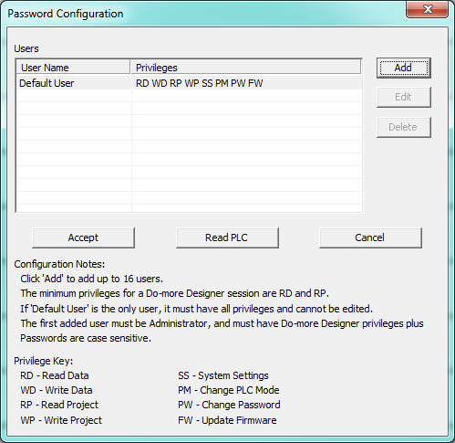
System Security
Multiple User Accounts
Do-more CPU has “Default User” predefined
Password is blank (cannot be changed)
Has all privileges
Privileges can only be modified after adding an Admin & logging in as Admin
First user created must be Administrator
Can add up to 16 users
Each account can have different levels of access
RD – Read Data SS – System Settings
WD – Write Data PM – Change PLC Mode
RP – Read Project PW – Change Password
WP – Write Project FW – Update Firmware
Minimum privileges are RD (Read Data) & RP (Read Project)

Slide 5
System Security
Multiple User Accounts
Privileges
*RD (Read Data) – allows reading of all data locations
WD (Write Data) – allows writing of all data locations
*RP (Read Project) – allows reading of the ladder program, system configuration & documentation from the PLC
WP (Write Project) – allows writing of the ladder program, system configuration & documentation to the PLC
SS (System Settings) – allows setting of system clock, clearing system & user logs
PM (Change PLC Mode) – allows changing of PLC mode (Program/Run) & invoking of debug features
PW (Change Password) – allows management of user accounts; without this privilege the Password Configuration cannot be opened
FW (Update Firmware) – allows updating of PLC’s firmware
*Minimum privilege

Slide 6
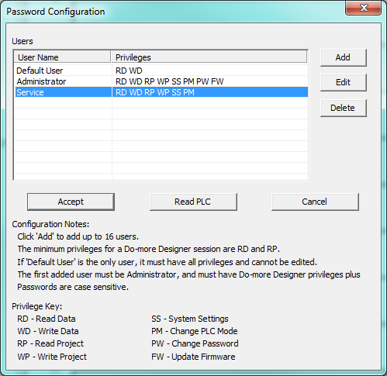
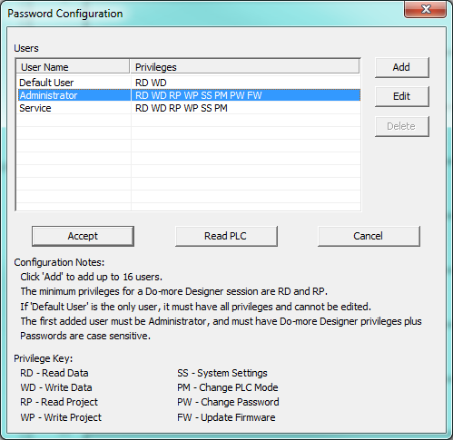
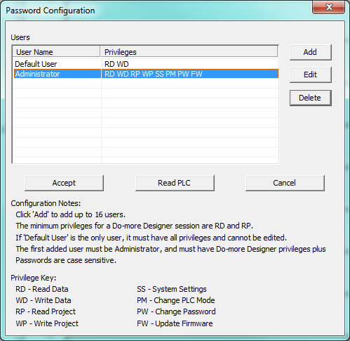
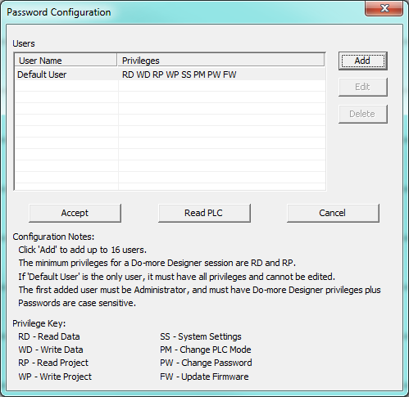
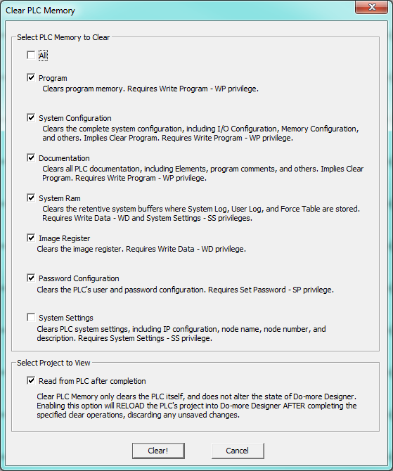
System Security
Multiple User Accounts
3 Ways to Clear the Password Configuration
(1) Use Password Configuration to delete User Accounts
Administrator can only be deleted if it is the only account
If Administrator is deleted, Default User resets to default privileges & blank password
(2) Clear PLC Memory with appropriate option
(3) Manual hardware reset

Slide 7
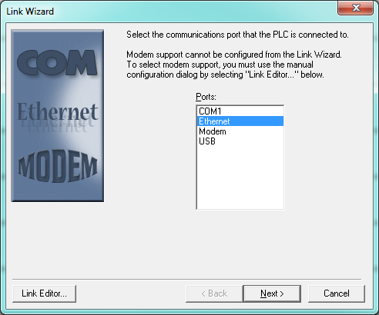
System Security
Session-based Communication
Unique ID used in all communication telegrams
If not present, PLC discards telegram
Prevents unauthorized access to PLC
Prevents other PCs from accessing wrong PLC
Sessions can timeout
If it times out, must be reestablished

Slide 8
System Security
Protocol-specific Memory (Guest Memory)
Prevents external devices from randomly accessing PLC’s I/O & memory
Modbus Protocol (RTU & TCP)
Server (Slave)
MI – Input
MIR – Input Register
MC – Coil
MHR – Holding Register
Client (Master)
Use MWX – Modbus Network Write instruction
Use MRX – Modbus Network Read instruction

Slide 9
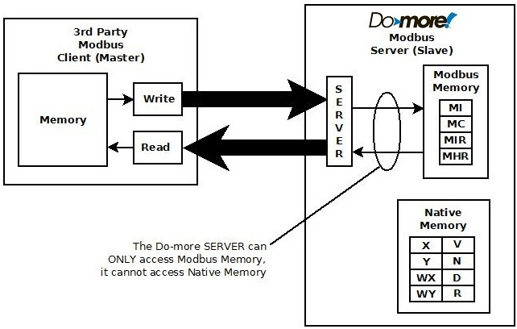
System Security
Protocol-specific Memory (Guest Memory)
Modbus Server (Slave)

Slide 10
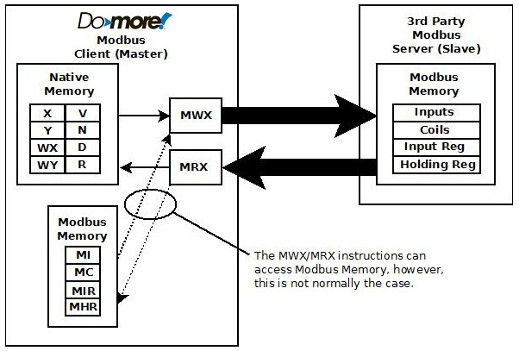
System Security
Protocol-specific Memory (Guest Memory)
Modbus Client (Master)

Slide 11
System Security
Protocol-specific Memory (Guest Memory)
DL Protocol (K-sequence)
Server (Slave)
DLX – Input
DLY – Output
DLC – Bit
DLV – V-memory
Client (Master)
Use DLWX – DirectLOGIC Network Write instruction
Use DLRX – Direct LOGIC Netwrok Read instruction
NOTE: DirectNET protocol is not supported

Slide 12
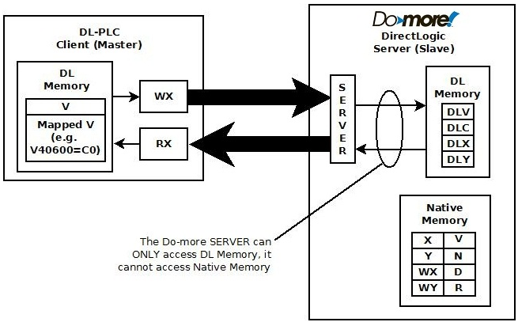
System Security
Protocol-specific Memory (Guest Memory)
DL Server (Slave)

Slide 13
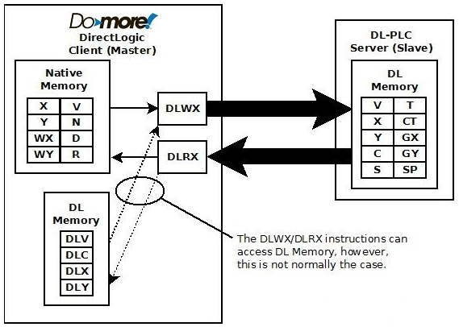
System Security
Protocol-specific Memory (Guest Memory)
DL Client (Master)

Slide 14
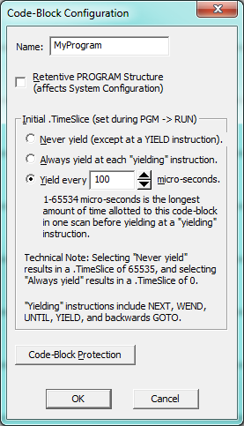
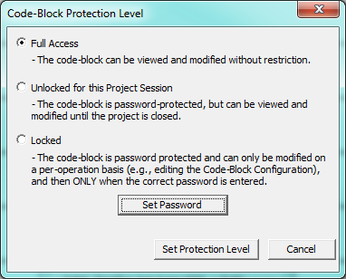
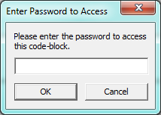
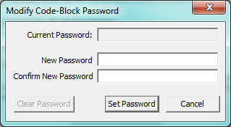
System Security
Code-Block Protection
Full Access
Viewed & modified without restriction
Unlocked for this Project Session
Password-protected, but can be viewed & modified until the project is closed.
Locked
Password-protected & can only be modified on a per-operation basis (e.g. editing the Code-Block Configuration), & then only when the correct Password is entered

Slide 15
System Security
Sessions Locked Out
CPU counts failed attempts to login
8 consecutive fails:
30-second lockout
$LoginLockedOut (ST150) = ON
This bit could be used in ladders to store the time (i.e. $Now (SDT0)) of the lockout
After 30 seconds:
Attempts can be resumed
$LoginLockedOut (ST150) = OFF
$FailedLoginCnt (DST386) is a running total of failed login attempts

Slide 16
System Security
Associated Instructions
DATAINFO (Category: Misc/Data Manipulation)
HWINFO (Category: Hardware/Device)

Slide 17
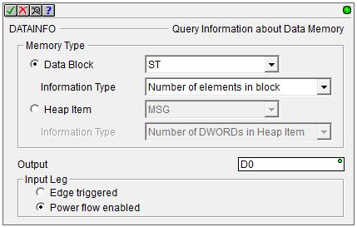
System Security
Schema ID | Description | Schema ID | Description
1 | BIT | 265 | File
2 | Unsigned BYTE | 266 | Program
3 | Signed BYTE | 267 | Device Reference
4 | Unsigned WORD
5 | Signed WORD | 268 | CTRIO
6 | Signed DWORD | 269 | CTRIO Counter
7 | REAL | 270 | CTRIO Timer
 |  | 271 | CTRIO Pulse Catch
256 | Timer | 272 | CTRIO Pulse
257 | Counter | 273 | CTRIO Discrete
258 | String | 274 | CTRIO Raw
259 | PID
260 | Clock | 275 | Drum
261 | Task | 276 | Stream
262 | Peerlink | 277 | Server
263 | RampSoak | 278 | Packet
264 | Reserved | 279 | Process Simulator
DATAINFO “Query Information about Data memory”
Reads the size or Schema ID of a Data Block or Heap Item
Parameters:
Memory Type:
Data Block – a list of all Data Blocks configured
Information Type:
Number of Elements in Block
Number of BYTEs in Block
Number of BITs in Block
Data Type ID (Schema ID)
Heap Item – a list of all Heap Items configured
Information Type:
Number of DWORDs in Heap Item
Data Type ID (Schema ID)
Output – location of read value
Input Leg
Edge triggered
Power flow enabled

Slide 18
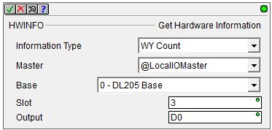
System Security
HWINFO “Get Hardware Information”
Reads hardware-specific info from I/O module
Parameters:
Information Type:
Module ID – see Help File for all IDs (there’s a bunch!)
X Count
Y Count
WX Count
WY Count
DX Count
DY Count
Master:
LocalIOMaster – local I/O base
EthIOMaster – Ethernet I/O remote base
Base
Slot
Output – location for read value

