Slide 1
Do-more Technical Training
Onboard Clock

Slide 2
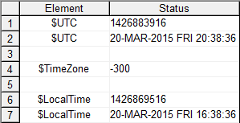
Onboard Clock
Accuracy: 1.53 minutes/month
Stored as UTC (Coordinated Universal Time)
Stored in $UTC (DST21)
Uses 1970 Epoch: number of seconds since 00:00:00, 01-January-1970
Adjusted by time zone
$TimeZone (DST384) – number of minutes
Adjusted by Daylight Savings Time
$SummerTime (ST768) – ON +1 hour
Adjusted time stored
$LocalTime (DST22) – UTC adjusted seconds
NOTE: These values are not very useful
Seconds
1970 Epoch

Slide 3
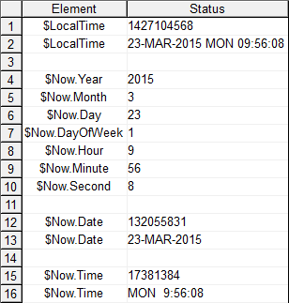
Onboard Clock
$LocalTime (DST22) is also stored as Date/Time structure:
$Now (SDT0) structure members:
Year – unsigned word
Month – unsigned byte
Day – unsigned byte
DayOfWeek – unsigned byte
0 = Sunday, 1 = Monday, etc.
Hour – unsigned byte
Minute – unsigned byte
Second – unsigned byte
Date – signed Dword
YYYYMMDD (use “Date Field” to see)
Time – signed Dword
DDHHMMSS (use “Time Field” so see)
NOTE: Date & Time structure members are not very useful except for some HMI displays
$SysShutdown (SDT1) – date/time of last power OFF
$SysStartup (SDT2) – date/time of last power ON

Slide 4
Onboard Clock (The Basics)
$UTC (DST21)
1,427,208,203 seconds
1970 Epoch
$TimeZone (DST284)
-300 minutes
Minutes
-18,000 seconds
= 1,427,190,203
$SummerTime (ST768)
ON = +1 hour
Bit
+3600 seconds
= 1,427,193,803
$LocalTime (DST22)
1,427,193,803
seconds
1970 Epoch
Date/Time Structure
$Now (SDT0)
$Now.Year (2015) $Now.Month (3)
$Now.Day (24)
$Now.DayOfWeek (2)
$Now.Hour (10)
$Now.Minute (43)
$Now.Second (23)

Slide 5
Onboard Clock
Setting the system clock:
Manually:
Set PLC Clock dialog
Auomatically:
(1) TimeSync function
(2) NETTIME “SNTP Client” instruction
(3) SETTIME “Set PLC Date/Time” instruction

Slide 6
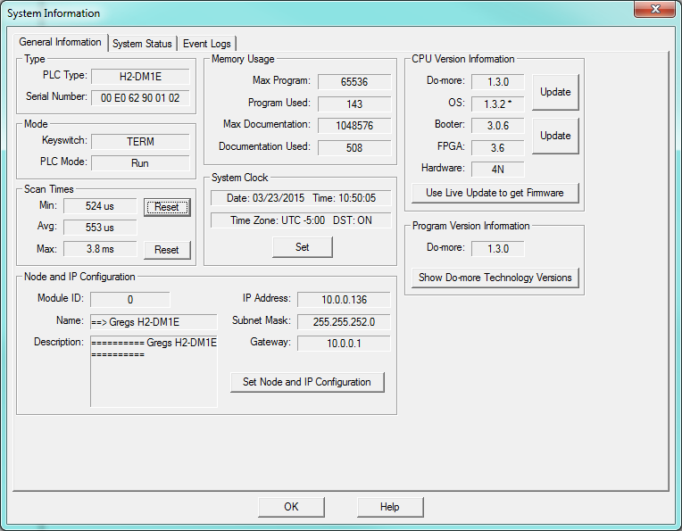
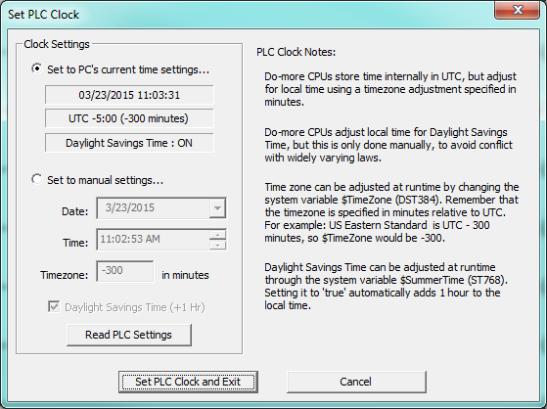
Onboard Clock
Manual Setting:
PLC → Set PLC Clock…

Slide 7
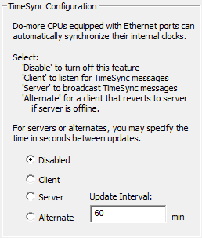
Onboard Clock
Automatic Setting:
(1) TimeSync function: CPU Configuration → TimeSync Configuration
Client:
Listens for server’s time-sync packet
If heard →
$TimeSynced (ST23) = ON
Sets onboard clock → $UTC (DST21)
Keeps listening (times down from Update Interval)
If Update Interval times out →
$TimeSynced (ST23) = OFF
Keeps listening (times down from Update Interval)
Server: transmits 3 time-sync packets (5 second intervals) every Update Interval)
Alternate:
Normally a Client
If Update Interval times out + 15 seconds →
Becomes the new Server
Update Interval: 0 – 32,767 minutes (22 days)

Slide 8
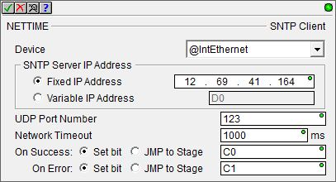
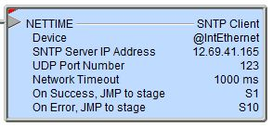
Onboard Clock
Automatic Setting:
(2) NETTIME “SNTP Client” instruction
Retrieves date/time from an SNTP (Simple Network Time Protocol) Server & stored in $UTC (DST21)
Parameters:
Device – onboard Ethernet port
SNTP Server IP Address
Fixed IP Address – IP address of SNTP Server
Variable IP Address – (32-bit word) variable IP address of SNTP Server commonly obtained by DNSLOOKUP “Name to IP Address” instruction
UDP Port Number – SNTP Protocol default is 123
Network Timeout – 1 to 65.535 seconds
On Success, On Error – Action to take
Instruction is leading-edge triggered
NOTE: NTP protocol is not supported
Notes:
* Program NETTIME using Richard’s SNTP server IP address

Slide 9
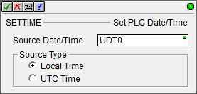
Onboard Clock
Automatic Setting:
(3) SETTIME “Set PLC Date/Time” instruction
Writes date/time to system clock
Writes $UTC (DST21) directly, or…
Writes $LocalTime (DST22) then…
…back-adjusts $UTC (DST21) based on:
$TimeZone (DST284) value
$SummerTime (ST768) bit
Parameters:
Source Date/Time – structure containing setting
Source Type:
Local Time – Source Date/Time represents local time
UTC Time – Source Date/Time represents UTC time
Instruction is leading-edge triggered
$UTC (DST21)
$TimeZone (DST284)
$SummerTime (ST768)
$LocalTime (DST22)
$Now (SDT0)

Slide 10
Onboard Clock
Programmatic use:
Assignment:
MEMCOPY “Copy Memory Range”
MOVE “Move Value”
Conversion:
DT2EPOCH “Convert Date/Time to 1970 Epoch”
EPOCH2DT “Convert Epoch to Date/Time”
MATH → NOW() function – Get Date/Time as a 32-bit integer (1970 Epoch)
Math-style operations:
DTCMP “Compare Date/Time”
DTDIFF “Difference between two Date/Times”
DTOFFSET “Add Offset to Date/Time”

Slide 11
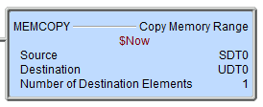
Onboard Clock
Programmatic use:
Assignment:
MEMCOPY “Copy Memory Range”
Use it to copy complete Date/Time structures

Slide 12
Onboard Clock
Programmatic use:
Assignment:
MOVE “Move Value”
Use it to copy single Date/Time structure members

Slide 13
Onboard Clock
Programmatic use:
Conversion:
DT2EPOCH “Convert Date/Time to 1970 Epoch”
Converts a Date/Time structure to 1970 Epoch value
Parameters:
Date/Time – structure to convert
1970 Epoch – location of converted value

Slide 14
Onboard Clock
Programmatic use:
Conversion:
EPOCH2DT “Convert Epoch to Date/Time”
Converts a 1970 Epoch value to Date/Time structure
Parameters:
1970 Epoch – seconds to convert
Date/Time – structure of converted value

Slide 15
Onboard Clock
Programmatic use:
Conversion:
MATH “Calculate Express” NOW() function
Converts the Date/Time structure $Now (SDT0) to 1970 Epoch value

Slide 16
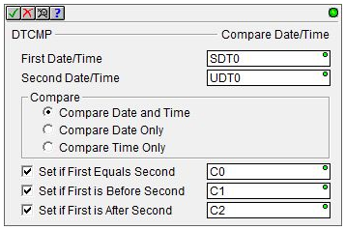
Onboard Clock
Programmatic use:
Math-style operations:
DTCMP “Compare Date/Time”
Compares two Date/Time structures
Parameters:
First Date/Time – 1st structure to be compared
Second Date/Time – 2nd structure to be compared
Compare:
Compare Date and Time
Compare Date Only
Compare Time Only
Set if First Equals Second
Set if First is Before Second
Set if First is After Second

Slide 17
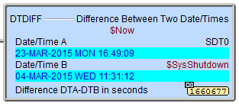
Onboard Clock
Programmatic use:
Math-style operations:
DTDIFF “Difference Between Two Date/Times”
Calculates the number of seconds of time between two Date/Time structures
Parameters:
Date/Time A
Date/Time B
Difference DTA-DTB in seconds

Slide 18
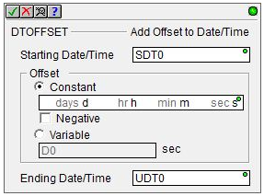
Onboard Clock
Programmatic use:
Math-style operations:
DTOFFSET “Add Offset to Date/Time”
Adds time to a Date/Time structure
Parameters:
Starting Date/Time
Offset
Constant – will be normalized
Negative
Variable – in seconds
Ending Date/Time

