Slide 1
BRX Technical Training
Subroutines

Slide 2
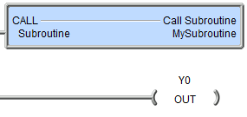
Subroutines
THE BASICS
Choose a Subroutine if your application requires…
An oft-repeated operation of some sort using different set of input/output parameters (e.g. a formula)
Invoked with a CALL “Call Subroutine” instruction
Scan branches to the subroutine and returns to the instruction just below the CALL when complete
The last instruction is always a RET “Return Back to CALL”
No edge-triggered instructions
No asynchronous instructions
No multi-scan instructions
No Stages
Has no memory structure members
Never yields
Execution order determined by the placement of the CALL instruction

Slide 3
Subroutines (Calling)
MyTask1
Project with Programs, Tasks and a Subroutine
This scan $Main, MyProgram1, MyTask2 & MyProgram2 all execute
This scan each of them call MySub
MySub called 4 times in 1 scan
Thus scan time is extended by the execution time of MySub x 4
$Main
MyProgram1
MySub
MySub
MyTask2
MyTask3
MyProgram2

Slide 4
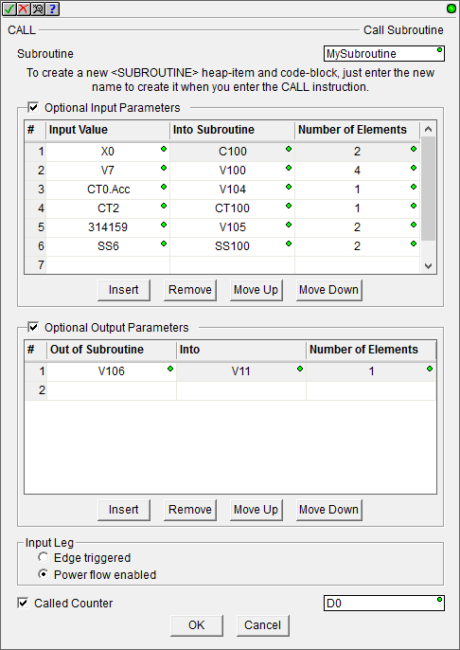
Subroutines
CALL “Call Subroutine”
Causes normal ladder scan to branch to Subroutine code
If Optional Input Parameters are defined, then values in Elements of Input Value column are copied to Elements in Into Subroutine column before branching occurs
After Subroutine executes & returns, if Optional Output Parameters are defined, then values in Elements of Out of Subroutine column are copied to Elements of Into column
Code in Subroutine should use Elements named in Into Subroutine & Out of Subroutine columns
----
----

Slide 5
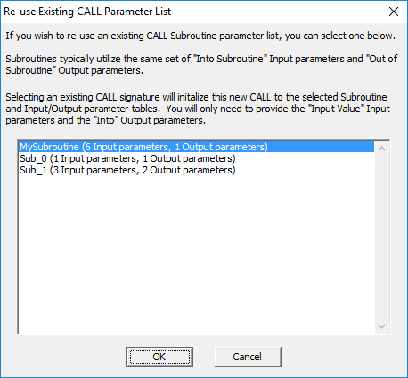
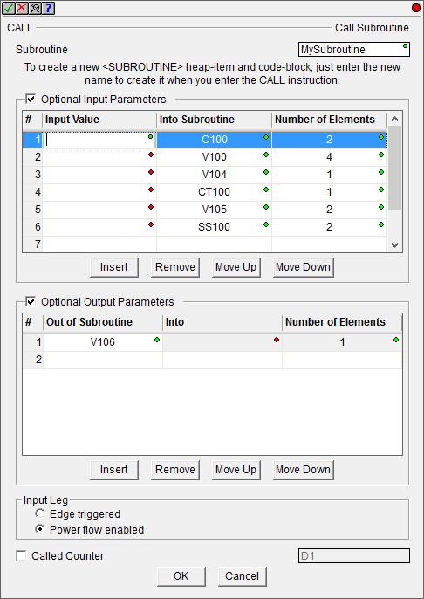
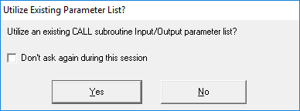
Subroutines
CALL “Call Subroutine”
Subroutines are meant to be reused each time with possible different input/output parameters
If Subroutines already exist & a new CALL instruction is programmed, Do-more Designer will help
If “No,” then you will have a fresh CALL to define
If “Yes,” then you can pick which list to use
Fill in the blanks
Notice Input Leg
Notice Counter

Slide 6
Subroutines
RET “Return Back to CALL”
Marks the end of a Subroutine
Automatically inserted when Subroutine is created
Unconditional output
No input logic is allowed
Use RETC “Conditional Return Back to CALL” if needed

Slide 7
Subroutines
RETC “Conditional Return Back to CALL”
Ends a Subroutine if the input logic is true
Conditional output
At least one Element is required for input logic
Can be used on multiple rungs
The RET “Return Back to CALL” is still required to mark the bottom of the Subroutine

