Slide 1
BRX Technical Training
Onboard Analog I/O

Slide 2
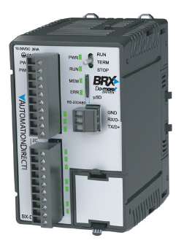
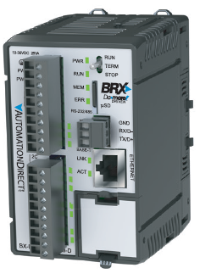
Onboard Analog I/O
BX10
6 discrete IN (all high-speed)
4 discrete OUT (2 high-speed)
No analog IN
No analog OUT
No Ethernet port
BX10E
6 discrete IN (all high-speed)
4 discrete OUT (2 high-speed)
1 analog IN
1 analog OUT
Ethernet port

Slide 3
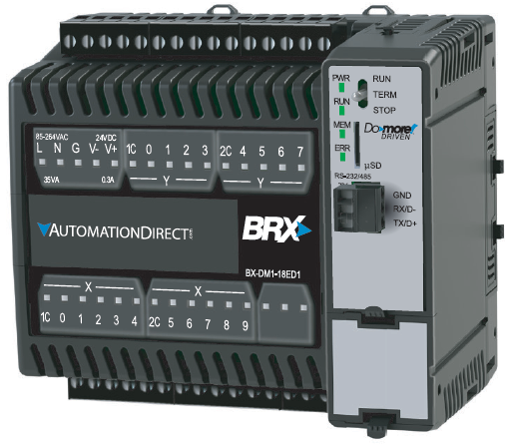
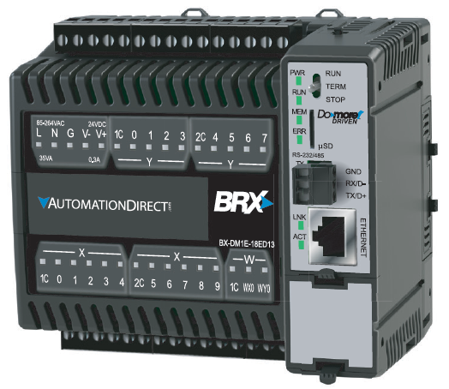
Onboard Analog I/O
BX18
10 discrete IN (all high-speed)
8 discrete OUT (4 high-speed)
No analog IN
No analog OUT
No Ethernet port
BX18E
10 discrete IN (all high-speed)
8 discrete OUT (4 high-speed)
1 analog IN
1 analog OUT
Ethernet port

Slide 4
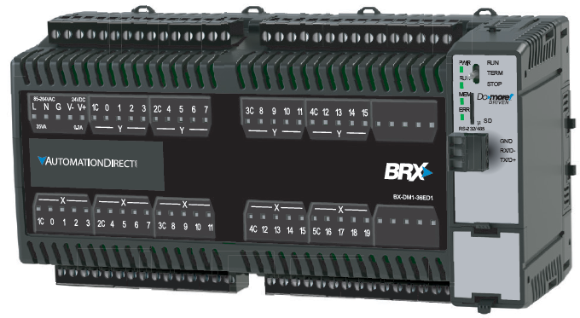
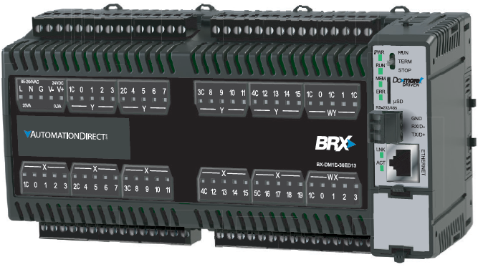
Onboard Analog I/O
BX36
20 discrete IN (10 high-speed)
16 discrete OUT (8 high-speed)
No analog IN
No analog OUT
No Ethernet port
BX36E
20 discrete IN (10 high-speed)
16 discrete OUT (8 high-speed)
4 analog IN
2 analog OUT
Ethernet port

Slide 5
Onboard Analog I/O
Each channel fully configurable
No need to specify characteristics for purchase
Configurable characteristics
Current VS Voltage
Voltage Ranges
0-5VDC, 0-10VDC, ±5VDC, ±10VDC
mA Ranges
4-20mA, ±20mA
Scale WX → RX-memory (real number)
With or without clamping
Scale RY-memory (real number) → WY
With or without clamping

Slide 6
Onboard Analog I/O
Analog Inputs
New memory type in Do-more: RX0. WX0 always contains the raw count; RX0 the scaled real number.

Slide 7
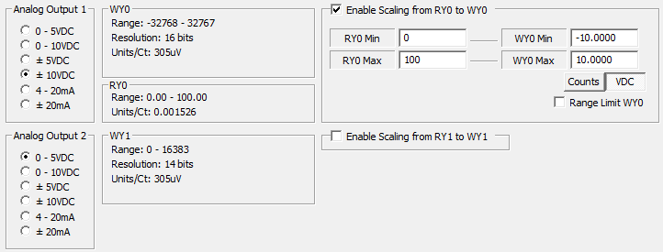
Onboard Analog I/O
Analog Outputs
New memory type in Do-more: RY0. WY0 always contains the raw count; RY0 the scaled real number.

