Slide 1
BRX Technical Training
Interrupt Service Routines (ISRs)

Slide 2
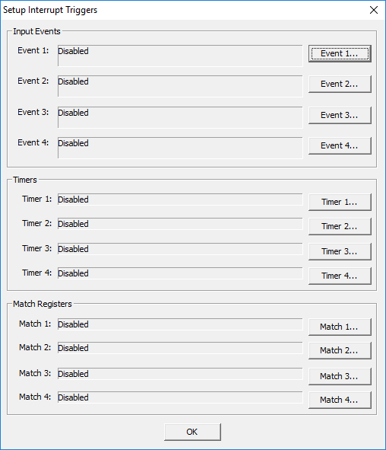
ISRs (The Basics)
Choose an ISR if your application requires…
An interrupting event that needs to be handled immediately (cannot wait on the normal scan of the PLC)
Triggered to run with a configured:
Event – based on the state of on-board input(s)
Timer – based on a hardware timer
Register Match – based on on-board I/O register(s) value(s)
Cannot be invoked in ladders (no instruction exists)
Trigger interrupts normal ladder scan and executes the ISR then returns to normal ladder scan where it left off
The same trigger cannot retrigger itself while running its own ISR
If triggers occur while an ISR is running:
Those triggers will run after the current ISR according to priority (not according to chronology):
Event1, Timer1, Match1, Event2, Timer2, Match2, Event3, Timer3, Match3, Event4, Timer4, Match4
No edge-triggered, asynchronous, multi-scan instructions, Stages or calls to Subroutines
Read INs
Ladder Logic
MyISR
Write OUTs

Slide 3
ISRs
Low
Priority
High
Trigger Register
0
1
0
0
1
0
0
1
0
0
0
0
0
0
0
Having completed running Match4’s ISR, the bit is cleared
Next in line to run is Event4
Timer2
Match1
Event2
Timer1
Event4
Event1
Timer4
Match4
Match3
Timer3
Event3
Match2
Having completed running Event4’s ISR, the bit is cleared
Having completed running Timer3’s ISR, the bit is cleared
Match4 triggers
Ladder Logic
Event4 triggers
Next in line to run is Timer3
Match4’s ISR
Even though Timer3 occurred after Event4, it is now the highest priority to run
Timer3’s ISR
Timer3 triggers
Event4’s ISR

Slide 4
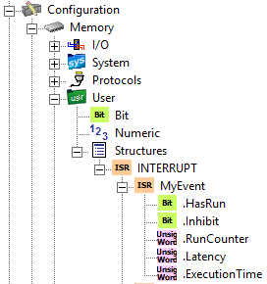
ISRs (The Basics)
Memory Structure Members
All readable/writable
.HasRun (bit) – ON if ISR has run at least one time since last Program-to-Run transition
.Inhibit (bit)
Set ON to prevent ISR from being executed when interrupt trigger occurs
Reset OFF to reenable ISR to run
.RunCounter (unsigned word) – number of times ISR has run since last Program-to-Run transition
.Latency (unsigned word) – time in ̲µsec from when the trigger happened to when the ISR is executed
.ExecutionTime (unsigned word) – time in µsec it takes the ISR to run

Slide 5
ISRs (Instructions)
Real Inputs
Normal PLC Scan
Code blocks only read/write Image Register
Normal PLC Scan w/Immediate Instruction
Instructions especially designed for ISRs:
These change the state of the specified bit immediately instead of waiting to change the bit as part of the normal I/O scan between scans
OUTI – Output Immediate Coil
RSTI – Reset Immediate Bit
SETI – Set Immediate Bit
Immediate instructions take more time because they write to the image register & directly to I/O
For example:
OUTI Y0 takes 6-7µs
OUT Y0 takes 1-2µs
Termination scan:
If used in ISR or Subroutine, no termination logic
If used in Program, Task or Stage, normal termination logic executed
Read Inputs
Read Inputs
Code Blocks
Code Blocks
Image Register
(INs)
Y0 in the real world output is written
Image Register
(OUTs)
OUTI Encountered
Y0 in Image Register is updated
Real Outputs
Write Outputs
Write Outputs

